Slide 2
Using Windows Runtime and SDK to build Metro style apps
John Lam
Principal Program Manager Lead
Microsoft Corporation

Slide 3

Beer
http://www.flickr.com/photos/kellbailey/1763951722/

Slide 4

Donuts
http://www.flickr.com/photos/msvg/5200730922/

Slide 5

Coffee
http://www.flickr.com/photos/visualpanic/334916864/

Slide 6

C#
http://en.wikipedia.org/wiki/File:Anders_Hejlsberg.jpg

Slide 7
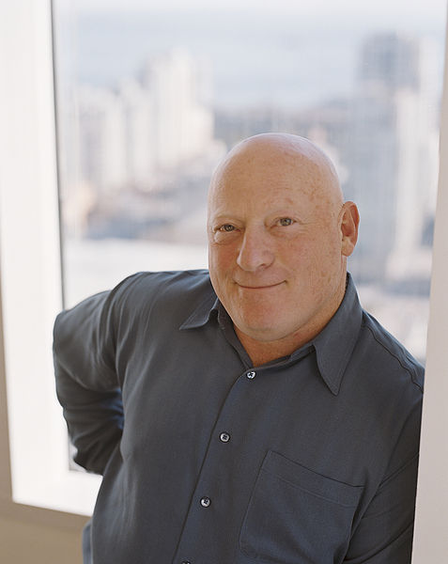
Visual Basic
http://en.wikipedia.org/wiki/File:AlanCooper.jpg

Slide 8
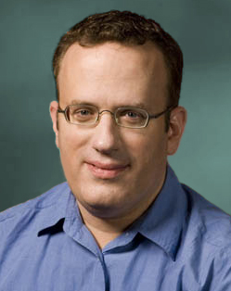
JavaScript
http://en.wikipedia.org/wiki/File:BEich.jpg

Slide 9
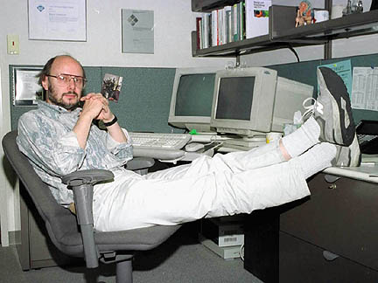
C++
http://en.wikipedia.org/wiki/File:BjarneStroustrup.jpg

Slide 10
Runtime Experience Team
JavaScript [Chakra]
C#/VB & CLR
C++ & Windows SDK

Slide 11
No Programmer Left Behind

Slide 12
WinRT and the Metro style SDK
Apps that are easy to create
Apps that are deeply integrated
Apps that are high quality
WinRT and the Metro style SDK

Slide 13
WinRT and the Metro style SDK
HTML/CSS/JavaScript
Use what you know
C#/VB/C++/XAML
Apps that are easy to create
C++/DirectX
3rd party existing code
Use what you have
Your existing code

Slide 14
WinRT and the Metro style SDK
Contracts
Samples
Apps that are deeply integrated
Capabilities
APIs

Slide 15
WinRT and the Metro style SDK
Async everywhere
Debugging
Apps that are high quality
Onboarding to Store
Trustworthy

Slide 16
Let’s code!
demo

Slide 17
WinRT and the Metro style SDK
Apps that are easy to create
Apps that are deeply integrated
Apps that are high quality
WinRT and the Metro style SDK

Slide 18


Related Content
Breakout Sessions
DEV352: What Web Developers Need to Know When Building Metro style Apps
DEV353: Building Metro style Apps with XAML
DEV354: Building Windows 8 Metro style UIs
DEV366: Building Metro style Apps with HTML and JavaScript

Slide 19

Track Resources
Required Slide
*delete this box when your slide is finalized
Track PMs will supply the content for this slide, which will be inserted during the final scrub.
Resource 1
Resource 2
Resource 3
Resource 4

Slide 20



Resources
Learning
Connect. Share. Discuss.
Microsoft Certification & Training Resources
http://northamerica.msteched.com
www.microsoft.com/learning
TechNet
Resources for IT Professionals
Resources for Developers
http://microsoft.com/technet
http://microsoft.com/msdn

Slide 21


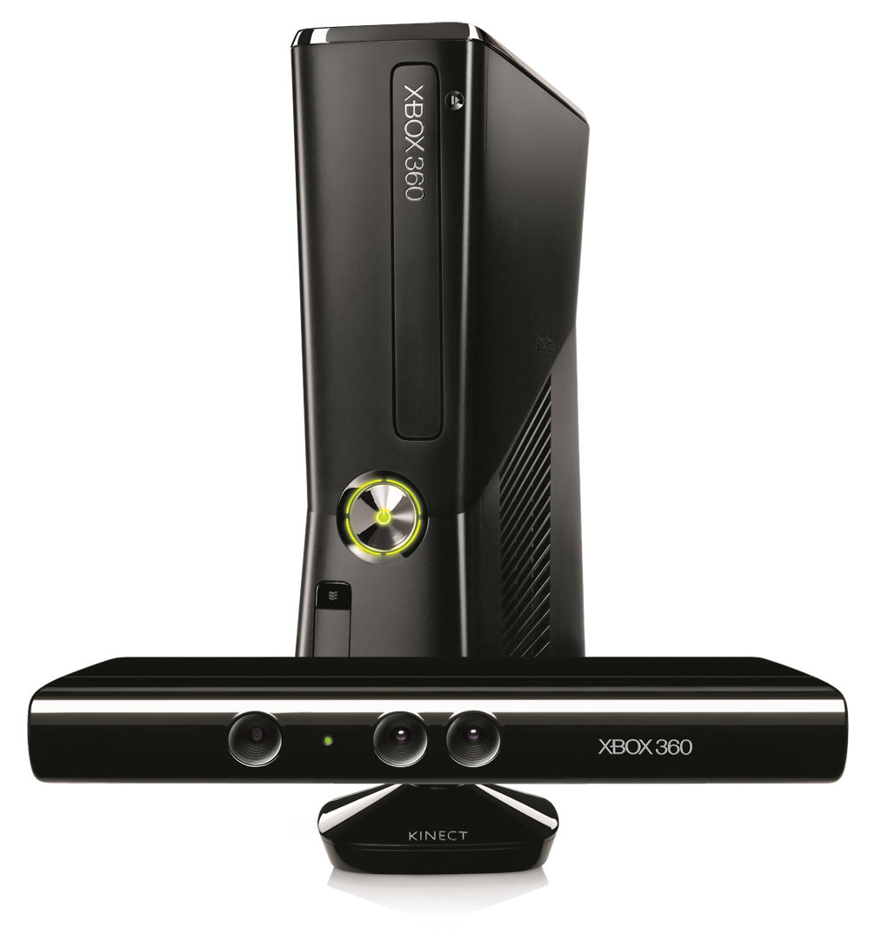




Required Slide
Complete an evaluation on CommNet and enter to win!

Slide 22

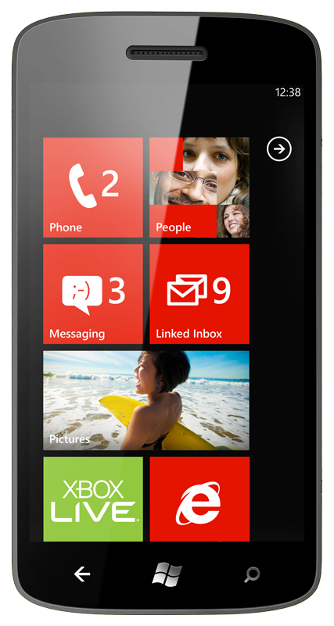
MS Tag
Required Slide
*delete this box when your slide is finalized
Your MS Tag will be inserted here during the final scrub.
Scan the Tag
to evaluate this
session now on
myTechEd Mobile
Notes:
TechEd is working with Microsoft Tag (http://tag.microsoft.com/overview.aspx) to create a unique Tag for every session at the event. Your session Tag will appear on both the room signage and at the end of your presentation. With your session Tag, attendees will be able to scan as they enter the room to retrieve session details, view speaker bios, and engage in discussions; or scan at the end of the presentation to evaluate your session and download materials.

Slide 23
© 2012 Microsoft Corporation. All rights reserved. Microsoft, Windows, Windows Vista and other product names are or may be registered trademarks and/or trademarks in the U.S. and/or other countries.
The information herein is for informational purposes only and represents the current view of Microsoft Corporation as of the date of this presentation. Because Microsoft must respond to changing market conditions, it should not be interpreted to be a commitment on the part of Microsoft, and Microsoft cannot guarantee the accuracy of any information provided after the date of this presentation. MICROSOFT MAKES NO WARRANTIES, EXPRESS, IMPLIED OR STATUTORY, AS TO THE INFORMATION IN THIS PRESENTATION.

